Slide 1
Parallel Programming Project
Dinakar & Nachiappan

Slide 2
Problem Statement
Deep learning uses large amounts of data to train models on GPUs. The host-GPU and GPU-GPU data transfers can easily dominate the execution time of model training.
Data compression, using lossless and lossy algorithms, may help with the cost.
Survey if data compression has been explored for deep learning, what algorithms have been investigated for what deep learning models, and how compression benefit deep learning model training.

Slide 3
Introduction
Deep Learning Training: A Deep Learning model of computer science can use GPU training effectively because it is a compute intensive task.
Interpretation of Problem statement: When deep learning training data is transferred from the CPU to the GPU, data needs to be compressed to ensure faster transfer.
Condition for success: Total time for Compression +/ Decompression + training must be smaller than training without compression.

Slide 4
Steps
Compress Deep Learning Training Data on CPU or load compressed data.
Send the data to the GPU.
Decompress the data on the GPU.
Train the Deep Learning model on the GPU.

Slide 5
Challenges
Compression Algorithm: The compression algorithm must be compatible with both CPU compression & GPU decompression.
Platform: The GPU platform must be capable of decompression of the CPU compressed data & training a deep learning model.

Slide 6
Technology
To facilitate the design and study of DNNs, a large number of machine learning (ML) frameworks have been developed in recent years and these frameworks extend GPU support.
Even GPU specific packages have been developed like Nvidia Caffe. These packages make it possible for GPU deep learning training with relative ease.
Eg: Caffe, Caffe2, Pytorch, etc

Slide 7
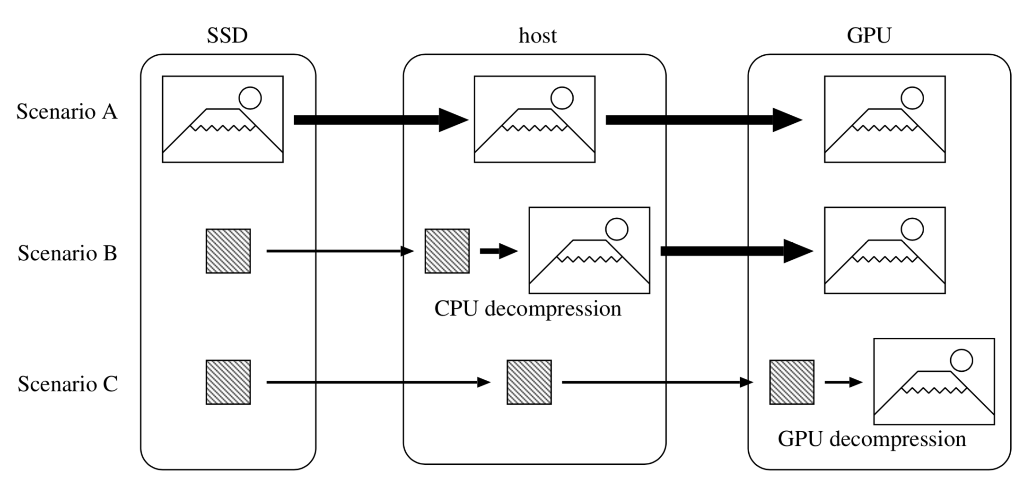
Three scenarios for evaluating the SSD-GPU loading time.
Fig: 4

Slide 8
Pipeline
Transfer of data from SSD to GPU for Training.
SSD
CPU
GPU
Compressed/ Uncompressed Training Data
Compress data if uncompressed
Decompress Data & Train Deep Learning Model

Slide 9
Compression Algorithm
The compression algorithm is one of the major challenges in finding the optimum runtime.
In this project we have studied 2 algorithms, namely ALL & Gompresso.
Ratio of compression sacrificed to minimize sequential dictionary update based compression.
Both algorithms are optimised to run on NVIDIA GPU -
32 threads in warp- 1 in and 1 more doing memory fetch
Memory Access
Invoking maximum number of threads. (eg:80mb-GeForce GTX 1080 GPU )

Slide 10
ALL(Adaptive Loss-Less)
The proposed algorithm comes from a recent paper by Funasaka et al (2017).
-Algorithms include: run-length coding, segment-wise coding, adaptive dictionary coding, and Huffman-based byte-wise coding.
-In run-length coding, a substring with the same character is encoded in a run-length code with a pair (character, length). For example, run-length codes (A,4)(B,3)(C,2) are decoded to AAAABBBCC.
-Sliding window compression technique is used in LZSS compression. It uses a dictionary buffer of a fixed size and an interval code with a pair (offset,length). This method use a fixed length dictionary size to compress and the dictionary content is changing (FIFO - First In First Out) in cycle as it progressing. Standard window size is 8bytes.

Slide 11
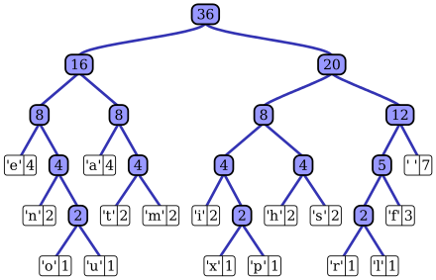
Huffman coding is a lossless data compression algorithm.
Steps: 1. Build a Huffman tree.
2. Traverse Tree to assign values.
Assign variable-length codes to input characters, lengths of the assigned codes are based on the frequencies of corresponding characters. The most frequent character gets the smallest code and the least frequent character gets the largest code.
The variable-length codes assigned to input characters are Prefix Codes, means the codes (bit sequences) are assigned in such a way that the code assigned to one character is not prefix of code assigned to any other character.

Slide 12
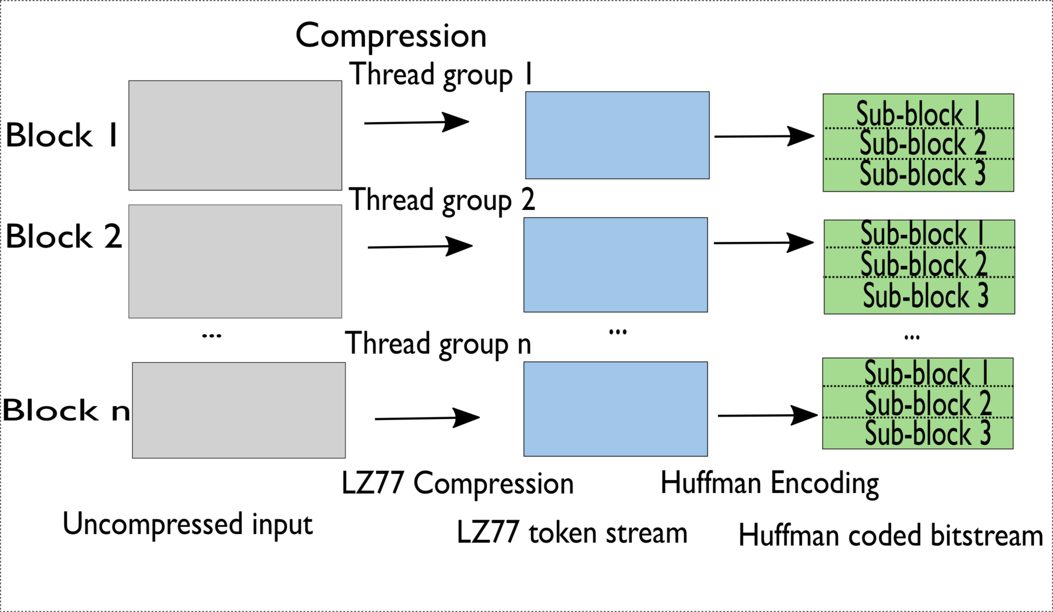
GOMPRESSO
A.Parallel Compression
Input is split into equally sized data blocks.
No of blocks is dependent on hardware.
LZ777 Compression
Huffman Encoding
It uses two separate huffman trees to facilitate huffman encoding
Fig:1 Compression

Slide 13
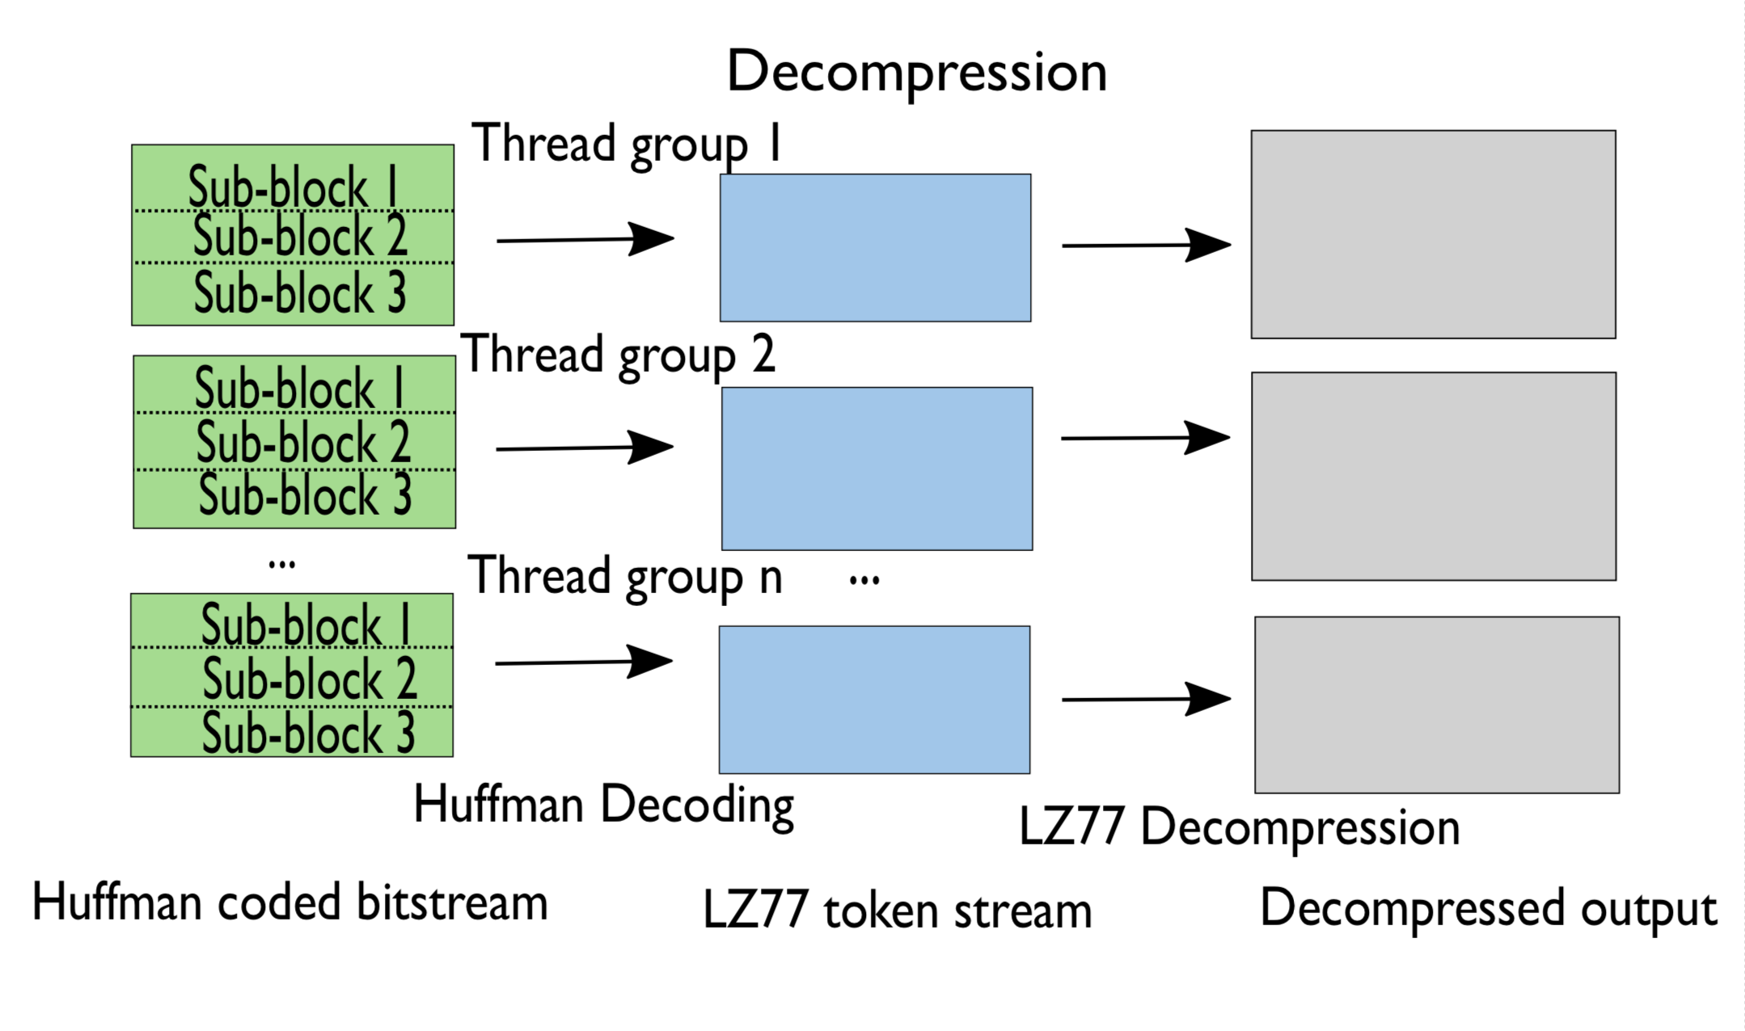
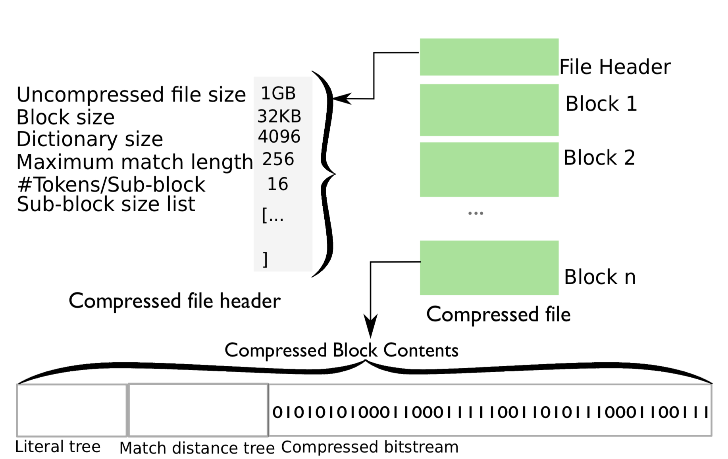
B.Parallel Decompression
Huffman Decoding
Sub blocks of a given data block decode their data streams using look-up tables created by the huffman trees.
LZ77 Decompression
Each data block is assigned to a single GPU warp for decompression.
Fig:2 Decompression
Fig:3 Compressed file format.

Slide 14
All threads in the warp concurrently alternate between executing instructions for string literals and for back references.
For each sequence, its thread performs:
(a) read its sequence from device memory and compute the start position of its string literal.
(b) determine the output position of its literal, and copy its string literal to the output buffer.
(c) resolve and write its back-reference.

Slide 15


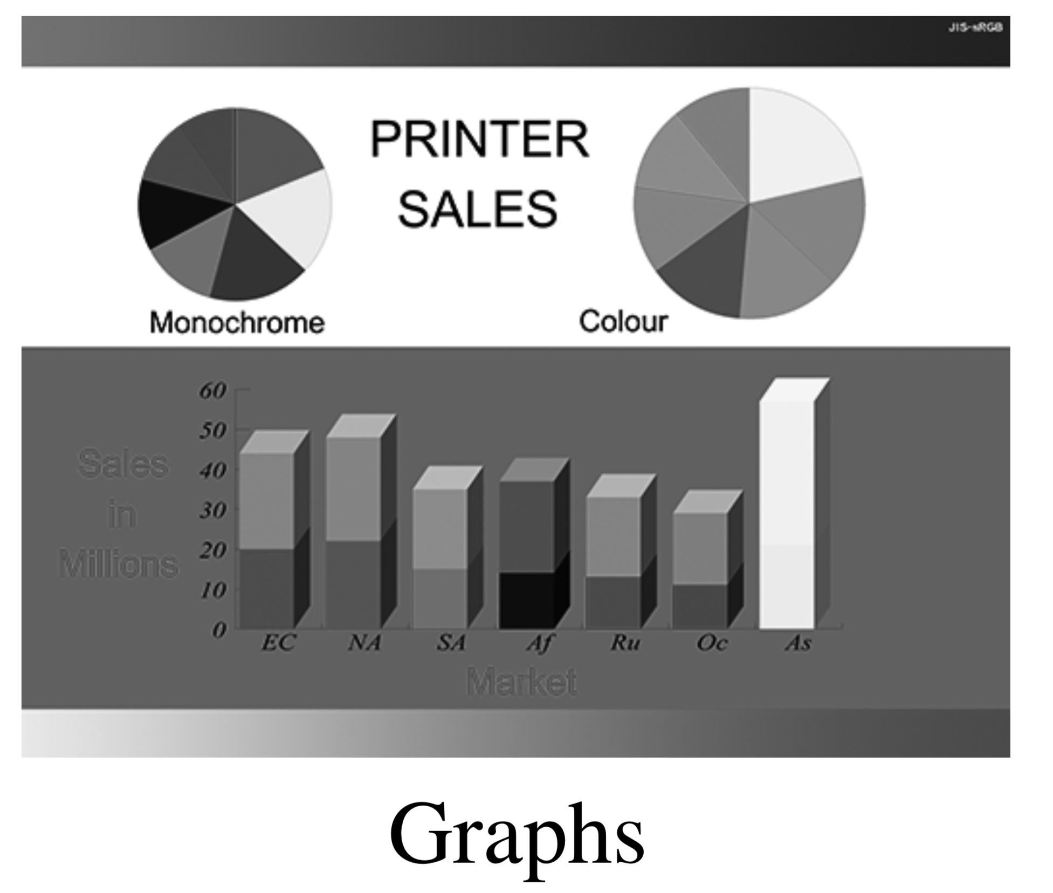
Data type

Slide 16
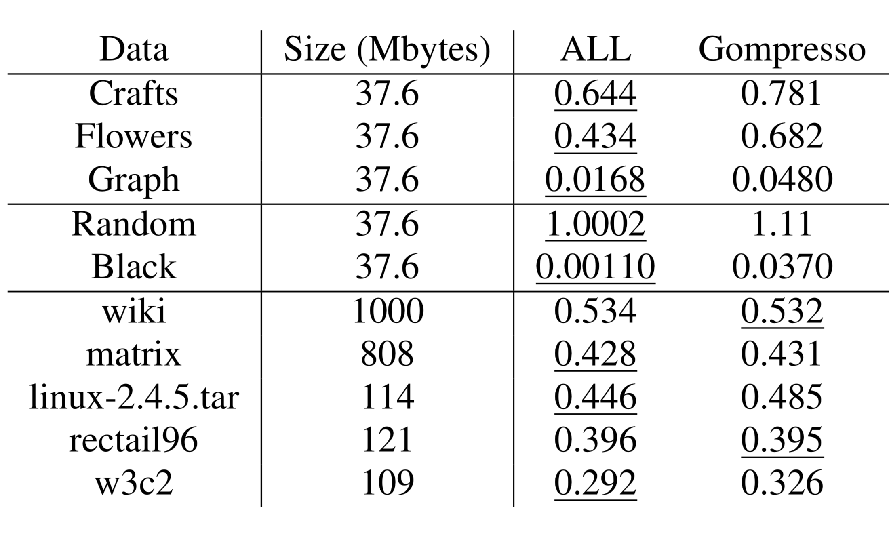
Observations:
Table:1 Compression Ratio

Slide 17
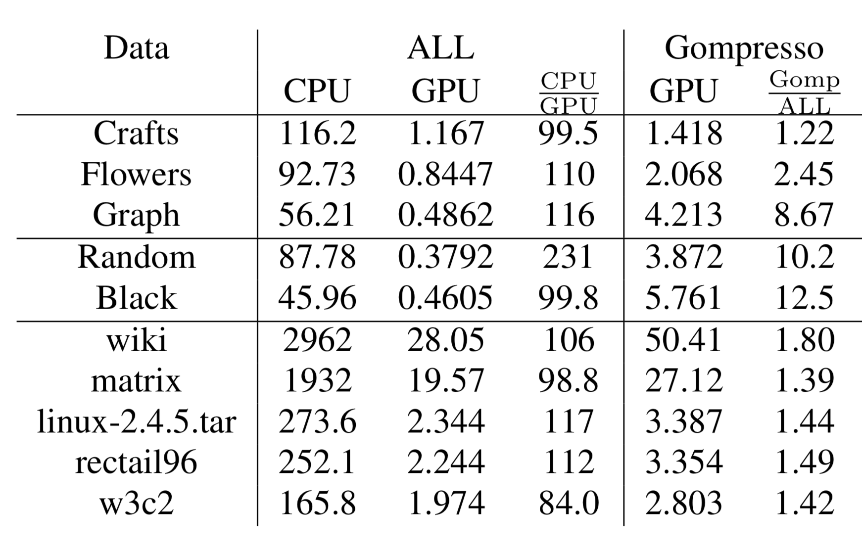
Running time for Decompression

Slide 18
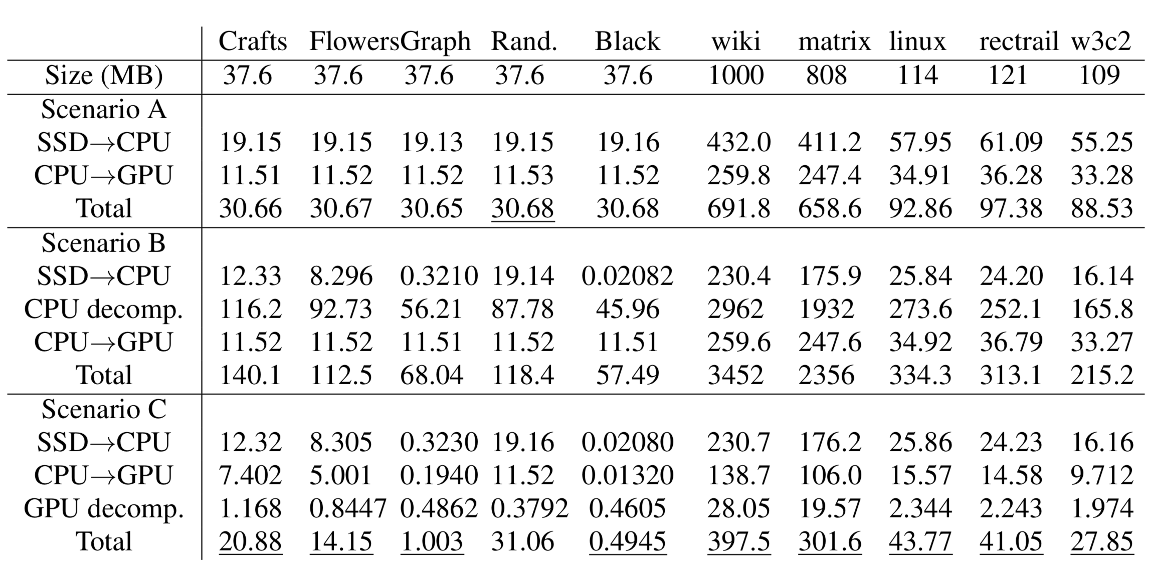
SSD to GPU loading time:
Table:3 *Underlined data is considered as the best.

Slide 19
Limitations of studies
The size of data was not varied even if different datasets were used- this makes the result an improper indicator of how efficient . Since compression is efficient only after a certain threshold is crossed- 80 MB in case of the ALL algorithm- 100% starting memory efficiency.
The compression is not a universal predictor across different GPUs- it was done on only certain Nvidia GPUs.
Deep Learning Layer modulation has not been studied sufficiently, w.r.t data compression, to draw conclusions.
Lossy algorithms haven’t been evaluated well yet.

Slide 20
Conclusion
The use of Compression algorithms to compress the deep learning training data is a good way to speed up training time if the data decompression on the GPU is efficient and fast.
On the other hand, the use of the compression algorithm is a good choice only if an appropriate algorithm is found for the type of data and the total time of execution is smaller than using a non-compressed dataset alone.

Slide 21
References & Citations
Compressing DMA Engine: Leveraging Activation Sparsity for Training Deep Neural Networks: Rhu, Minsoo & O'Connor, Mike & Chatterjee, Niladrish & Pool, Jeff & Kwon, Youngeun & W. Keckler, Stephen. (2018). Compressing DMA Engine: Leveraging Activation Sparsity for Training Deep Neural Networks. 78-91. 10.1109/HPCA.2018.00017.
Adaptive loss-less data compression method optimized for GPU decompression. Funasaka, Shunji & Nakano, Koji & Ito, Yasuaki. (2017). Adaptive loss-less data compression method optimized for GPU decompression. Concurrency and Computation: Practice and Experience. 29. e4283. 10.1002/cpe.4283.
Sitaridi E, Mueller R, Kaldewey T, Lohman G, Ross KA. Massively-parallel lossless data decompression. InParallel Processing (ICPP), 2016 45th International Conference on 2016 Aug 16 (pp. 242-247). IEEE.
Algorithms for Compression on GPUs, Anders L. V. Nicolaisen, s112346
Why are GPUs necessary for training Deep Learning models? https://www.analyticsvidhya.com/blog/2017/05/gpus-necessary-for-deep-learning/

